Slide 1
Computer Networks
Foundation
S.V.Jansi Rani
Assistant Professor / CSE

Slide 2
Problems
How to build a scalable network that will support different applications?
What is a computer network?
How is a computer network different from other types of networks?
What is a computer network architecture?

Slide 3
Chapter Outline
Applications
Requirements
Network Architecture
Implementing Network Software
Performance

Slide 4
Chapter Goal
Exploring the requirements that different applications and different communities place on the computer network
Introducing the idea of network architecture
Introducing some key elements in implementing Network Software
Define key metrics that will be used to evaluate the performance of computer network

Slide 5
Applications
Most people know about the Internet (a computer network) through applications
World Wide Web
Email
Online Social Network
Streaming Audio Video
File Sharing
Instant Messaging
…

Slide 6
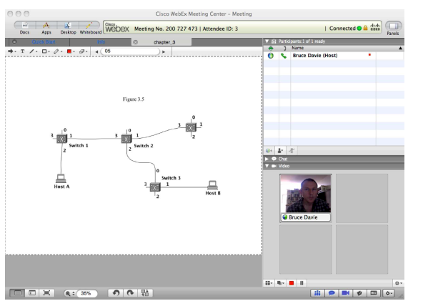
Example of an application
A multimedia application including video-conferencing

Slide 7
Application Protocol
URL
Uniform resource locater
http://www.cs.princeton.edu/~llp/index.html
HTTP
Hyper Text Transfer Protocol
TCP
Transmission Control Protocol
17 messages for one URL request
6 to find the IP (Internet Protocol) address
3 for connection establishment of TCP
4 for HTTP request and acknowledgement
Request: I got your request and I will send the data
Reply: Here is the data you requested; I got the data
4 messages for tearing down TCP connection

Slide 8
Requirements
Application Programmer
List the services that his application needs: delay bounded delivery of data
Network Designer
Design a cost-effective network with sharable resources
Network Provider
List the characteristics of a system that is easy to manage

Slide 9
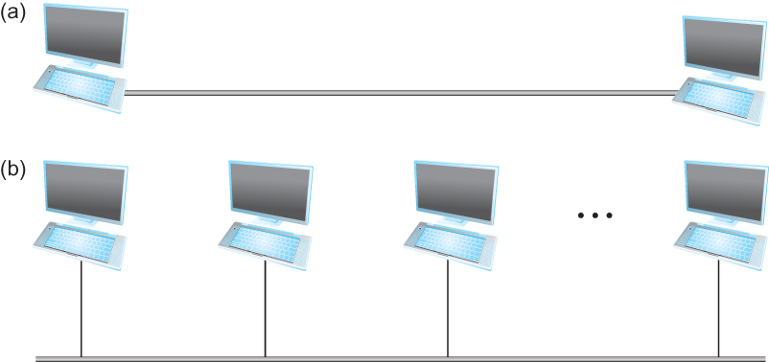
Connectivity
Need to understand the following terminologies
Scale
Link
Nodes
Point-to-point
Multiple access
Switched Network
Circuit Switched
Packet Switched
Packet, message
Store-and-forward
Point-to-point
Multiple access

Slide 10
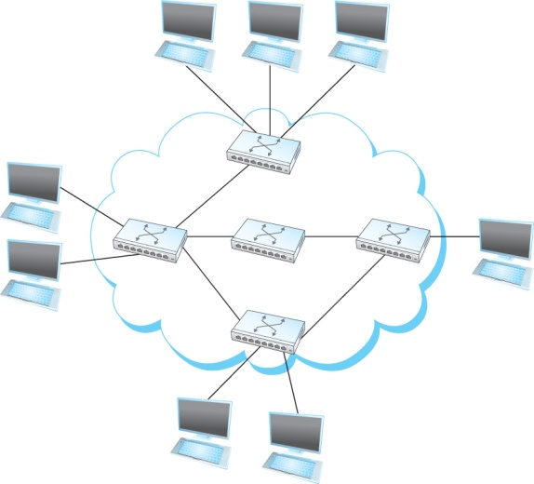
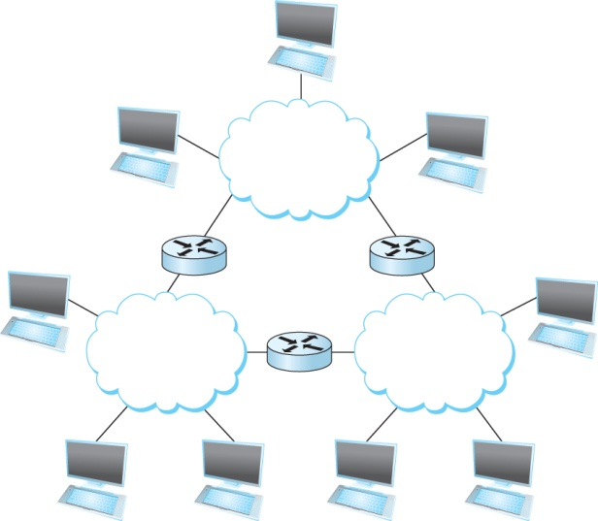
Connectivity
Terminologies (contd.)
Cloud
Hosts
Switches
internetwork
Router/gateway
Host-to-host connectivity
Address
Routing
Unicast/broadcast/multicast
(a)
(b)
A switched network
Interconnection of networks

Slide 11
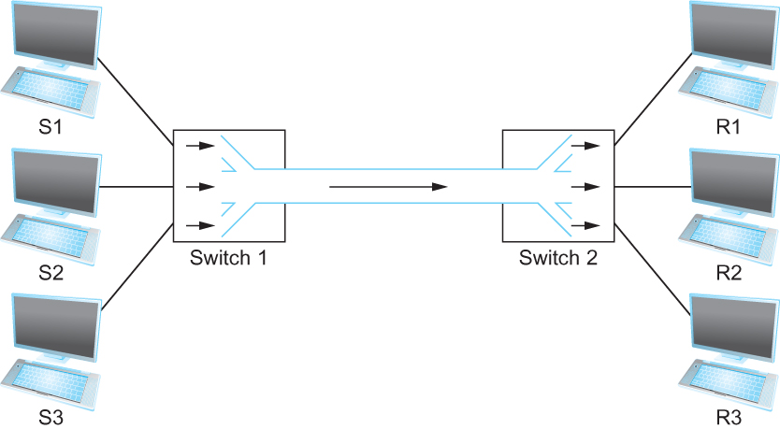
Cost-Effective Resource Sharing
Resource: links and nodes
How to share a link?
Multiplexing
De-multiplexing
Synchronous Time-division Multiplexing
Time slots/data transmitted in predetermined slots
Multiplexing multiple logical flows over a single physical link

Slide 12
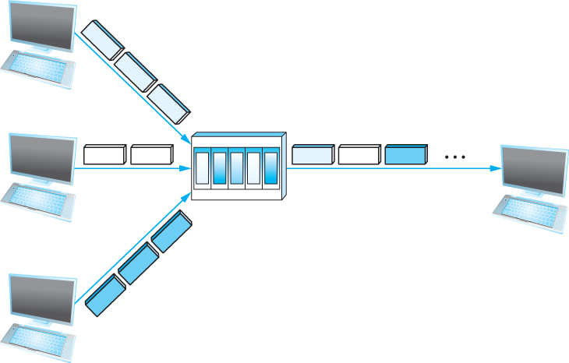
Cost-Effective Resource Sharing
FDM: Frequency Division Multiplexing
Statistical Multiplexing
Data is transmitted based on demand of each flow.
What is a flow?
Packets vs. Messages
FIFO, Round-Robin, Priorities (Quality-of-Service (QoS))
Congested?
LAN, MAN, WAN
SAN (System Area Networks
A switch multiplexing packets from multiple sources onto one shared link

Slide 13
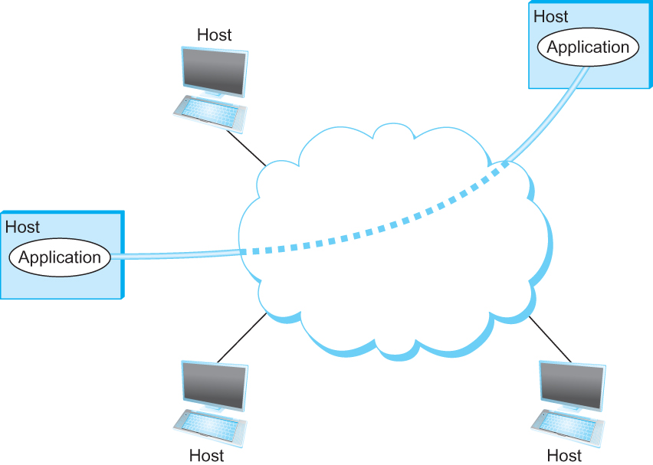
Support for Common Services
Logical Channels
Application-to-Application communication path or a pipe
Process communicating over an abstract channel

Slide 14
Common Communication Patterns
Client/Server
Two types of communication channel
Request/Reply Channels
Message Stream Channels

Slide 15
Reliability
Network should hide the errors
Bits are lost
Bit errors (1 to a 0, and vice versa)
Burst errors – several consecutive errors
Packets are lost (Congestion)
Links and Node failures
Messages are delayed
Messages are delivered out-of-order
Third parties eavesdrop

Slide 16
Summary
We have identified the various applications
We have identified what we expect from a computer network
We have defined various requirements

